Slide 1
前言

Slide 2

你一定经历过这些令人挠头的事情
优化了一段代码，
结果藏了坑。
拥抱变化 = 拥抱BUG
我们组缺QA，
缺文档，
需求靠嘴
哪个小伙伴改崩
了我的代码？

Slide 3
Test Driven Development

Slide 4
0
1
啥是TDD？
目录
02
TDD如何帮我们开发
03
带你TDD
04
闲聊TDD
contents

Slide 5
01
啥是TDD？

Slide 6
啥是TDD
Test
Task
Development
Design
Driven

Slide 7
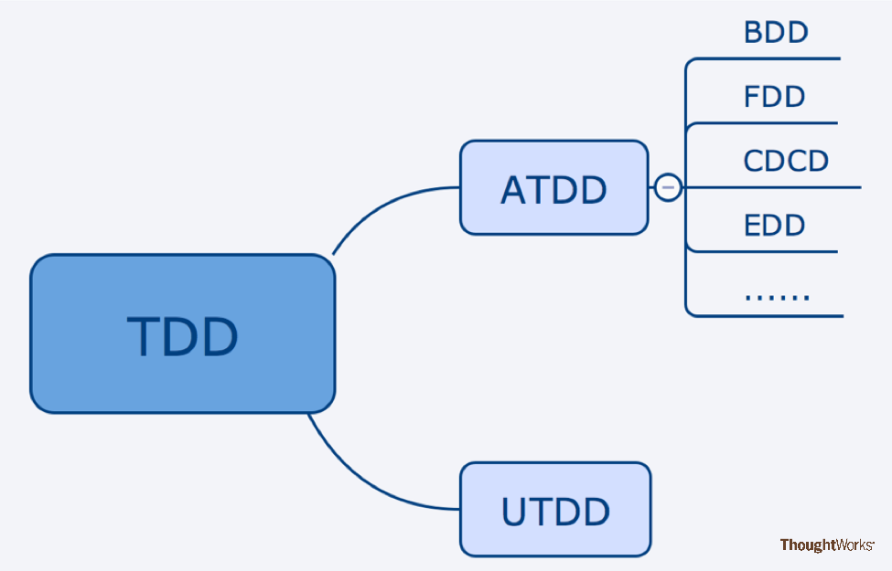
啥是TDD

Slide 8
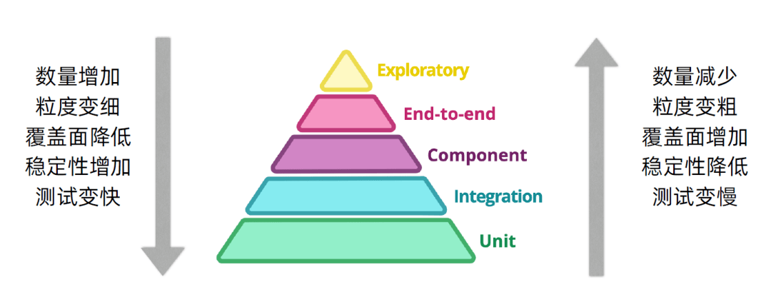
Unit Test
单元测试（unit testing），是指对软件中的最小可测试单元进行检查和验证。

Slide 9

UT有啥好处
验证正确性
测试提高设计
（尤其是TDD）
测试即是文档
提高可回归性

Slide 10
02
TDD如何帮我们开发？

Slide 11

传统开发流程
1. 需求分析，脑子里设计一下代码，开搞。
2. 好像有点不对，找产品聊细节，打补丁，接着干。
3. 终于跑通了，提交QA。
4. 被抓BUG，打补丁，打补丁。
5. 终于通过测试了，留下一片补丁，💩山诞生。
6.无力优化代码，凑合上线吧。
7. 也许你会补充UT。

Slide 12
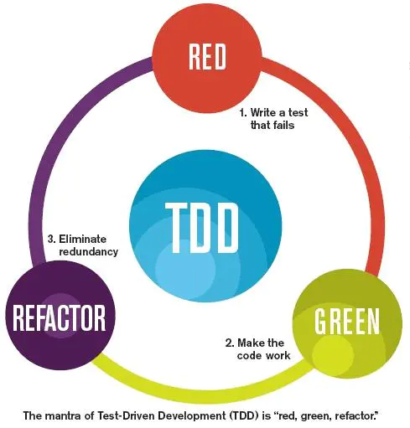
TDD开发流程
测试先行
反复重构

Slide 13
TDD开发流程
1. 需求分析，强迫思考所有的功能，不关心实现，先写测试。
2. 好像有点不对，找产品聊细节，补充测试。
3. 写代码，跑通所有用例。
4. 优化代码，因为有测试，不怕引发bug。
5. 把整洁的代码提交QA
6 被抓BUG，功能应该不会错，肯定是漏了逻辑了。
7. 补充测试用例，在原有的好代码上加逻辑
8. 再重构。
此时你得到了：
一份文档
一份健壮，整洁的代码。
扩展功能的信心
QA同学少卷点

Slide 14
03
带你TDD

Slide 15
点击输入标题
点击输入标题
So there’s nothing stopping you from picking up a valuable new skill this month. Let’s get started…
点击输入标题
So there’s nothing stopping you from picking up a valuable new skill this month. Let’s get started…
So there’s nothing stopping you from picking up a valuable new skill this month. Let’s get started…
点击输入标题
点击输入标题
点击输入标题
So there’s nothing stopping you from picking up a valuable new skill this month. Let’s get started…
So there’s nothing stopping you from picking up a valuable new skill this month. Let’s get started…
So there’s nothing stopping you from picking up a valuable new skill this month. Let’s get started…
2014
2015
2016
2017
2018
2019

Slide 16

添加标题
eptember is around the corner, so why not celebrate the beginning of a new season by committing to learning some new skills?
Whether you’re a graphic designer, an entrepreneur, a web designer or a developer, this post will give you some great ideas for learning new skills. We’ll go through some great courses and tutorials on graphic design, web design, coding, and more.
Many of these resources are free, and others are included in a subscription. So there’s nothing stopping you from picking up a valuable new skill this month. Let’s get started…
 

Slide 17
03
年度工作概述
Please click to enter the general description text of this chapter or copy and paste it. Please add the description text, image description and summary.

Slide 18
添加标题
01
eptember is around the corner, so why not celebrate the beginning of a new season by committing to learning some new skills?
请替换文字内容
eptember is around the corner, so why not celebrate the beginning of a new season by committing to learning some new skills?
关键词
02
eptember is around the corner, so why not celebrate the beginning of a new season by committing to learning some new skills?
03
eptember is around the corner, so why not celebrate the beginning of a new season by committing to learning some new skills?

Slide 19

添加标题
eptember is around the corner, so why not celebrate the beginning of a new season by committing to learning some new skills? eptember is around the corner, so why not celebrate the beginning of a new season by committing to learning some new skills?
标题文本预设
Whether you’re a graphic designer, an entrepreneur, a web designer or a developer, this post will give you some great ideas for learning new skills. We’ll go through some great courses and tutorials on graphic design, web design, coding, and more.

Slide 20
放映结束，感谢观看
At the end of the show, thank you for watching.
汇报人：XX
日期：XX

